Slide 1
Simulink Design Verifier Workshop

Slide 2
Table of contents
What is Simulink Design Verifier
How SLDV works
Configuration settings of SLDV
SLDV Blocks
Ensuring the compatibility to SLDV
Coverage analysis of a model
Automatic test case generation
Test Condition block and Assumption block
The user defined test by Test Objective block
The technique effectively using SLDV

Slide 3
Table of contents (continuation)
Block replacement
Parameter configuration
Property proving
What should be proved by property proving?
Use of Property Specification UI
About the performance of Property proving
Design error detection

Slide 4
What is Simulink Design Verifier
Test case automatic generation
The function which generates automatically the test input signal which fills the model coverage of a Simulink control model
Property proving
The function to verify that property you specified by a logical expression is always identical to the controller model for every time series input(s).
Design error detection
The function to verify that no run-time errors such as divide-by-zero or overflow can be occurred in a model.
* Simulink Design Verifier : Often abbreviated as SLDV.

Slide 5

The analytic engine of SLDV
Prover Plug-In
The verification engine which Prover Technology develops.
Formal verification based on model checking.
It is adopted with the verification tool in various domains, and has a track record for about 20 years.
http://www.prover.com/products/prover_plugin/
Polyspace (R2011a or later release)
The verification engine which MathWorks develops.
It will be developed by old PolySpace Technology in 1999, and MathWorks acquired Polyspace in 2007.
Formal verification based on an abstract.

Slide 6
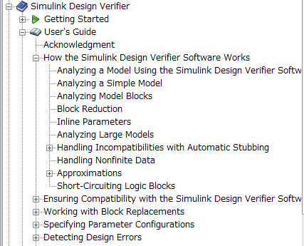
How SLDV works

Slide 7
How SLDV Works #1
SLDV always starts analysis from the initial configuration (t==0) of a model.
Although an input value and time generally have infinite search space, SLDV analyzes in limited time using the method of reducing search space.
Various kinds of mathematical techniques are applied to reduction of search space.
Limits the analysis by tracking the persistent information in the model such as discrete states, data-store memories, and persistent variables.
After an analysis explores all possible inputs and parameters from all possible configurations, the results are equivalent to those of a complete search of every possible infinite sequence of input parameters.

Slide 8
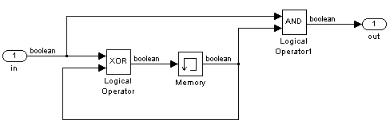
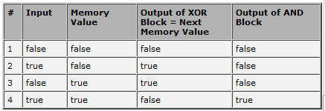
How SLDV Works #2 Simple example
Understanding how SLDV works
The table shows all the combination of an input value and a state variable.
From this table, SLDV searches a combination that meets Test Objective.
If there is the combination, test cases are represented from the table.
Model made into an exercise :
1 Boolean Input
One state
m_sample01.mdl

Slide 9
Test generation to an exercise simple model
When the initial value of Memory is false, two steps are required in order to use output out == true.
The 2nd (0 step) line : Input == true and Memory == false
The 4th (1 step) line : Input == true and Memory == true
Output out == false is not relevant to state variable, therefore it is achievable every time step. (the 1st line, the 3rd line).
When SLDV searches a test objective, it returns the first test case it encounters that satisfied the objective.
This principle is common in test case generation and Property proving.

Slide 10
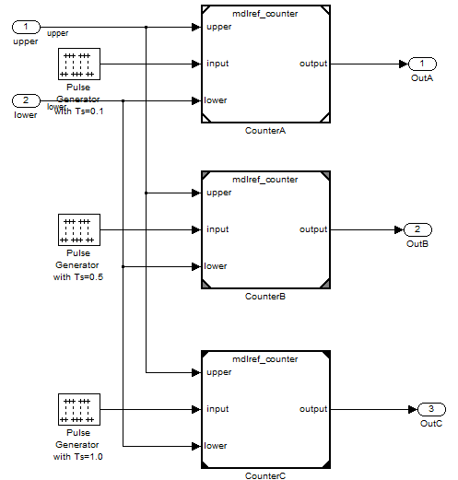
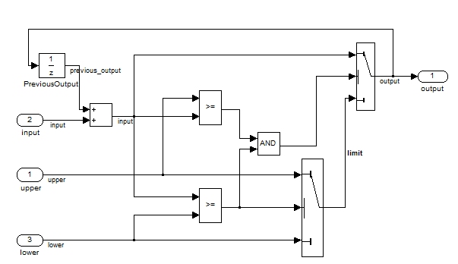
Analysis of a model block
As for the analysis to a parent model including a model reference block, test generation and coverage measurement are performed in consideration of the instance of each child model.
Even if it is referring to the same model, it is treated as a separate instance.

Slide 11
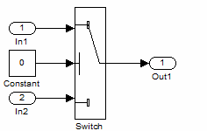
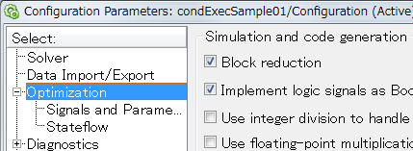
Influence of Block reduction
The Block reduction setting in
Configuration parameter > optimization
can influence to SLDV analysis.
When block reduction is enabled the execution path which is not used can automatically be deleted like the time of a simulation.
Since only the 3rd input of Switch becomes effective when Switch conditions are u2~=0, the test objective of a Switch block does not count from the analysis of SLDV.

Slide 12
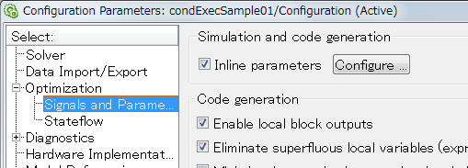
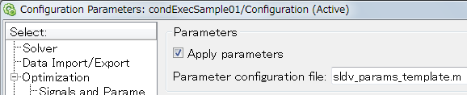
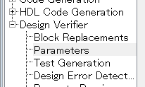
Influence of an Inline Parameters
When the Simulink Design Verifier software translates a model, it transforms all tunable parameters in the model into constant values, even if the Inline parameters option is off.
To make it tunable, use "Apply parameters" feature provided by SLDV.

Slide 13
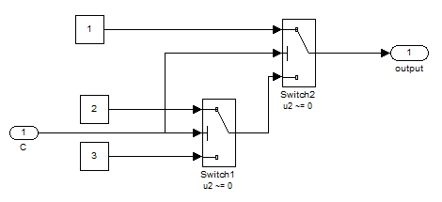
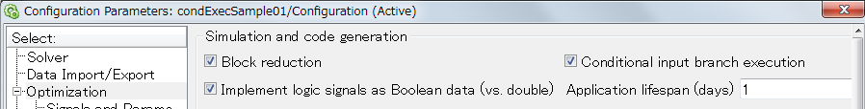
Influence of Conditional input branch execution
%Disabled
if (C~=0)
tmp = 2;
else
tmp = 3;
end
if (C~=0)
output = 1;
else
output = tmp;
end
%Enabled
if (C~=0)
output = 1;
else
if (C~=0)
output = 2;
else
output = 3;
end
end
It becomes "dead path"
condExecSample01.mdl

Slide 14
Understanding SLDV configurations

Slide 15
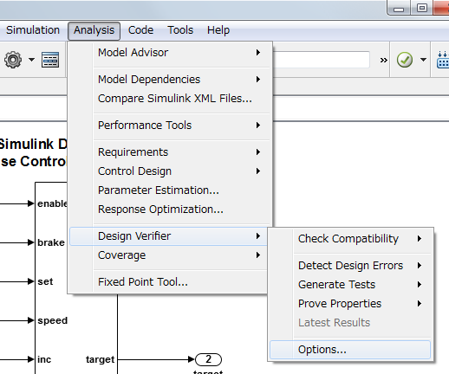
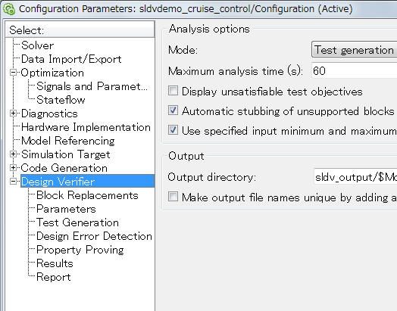
To open SLDV configuration
Once SLDV configuration is called, it will be attached to Configuration set of the model. Then you will see SLDV configurations in the Configuration parameter Window.

Slide 16
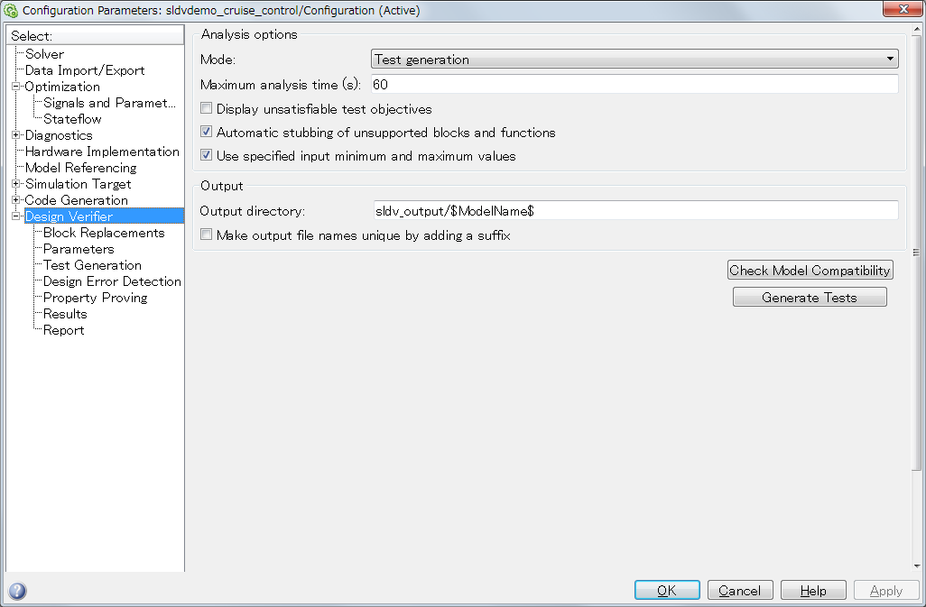
Design Verifier pane

Slide 17
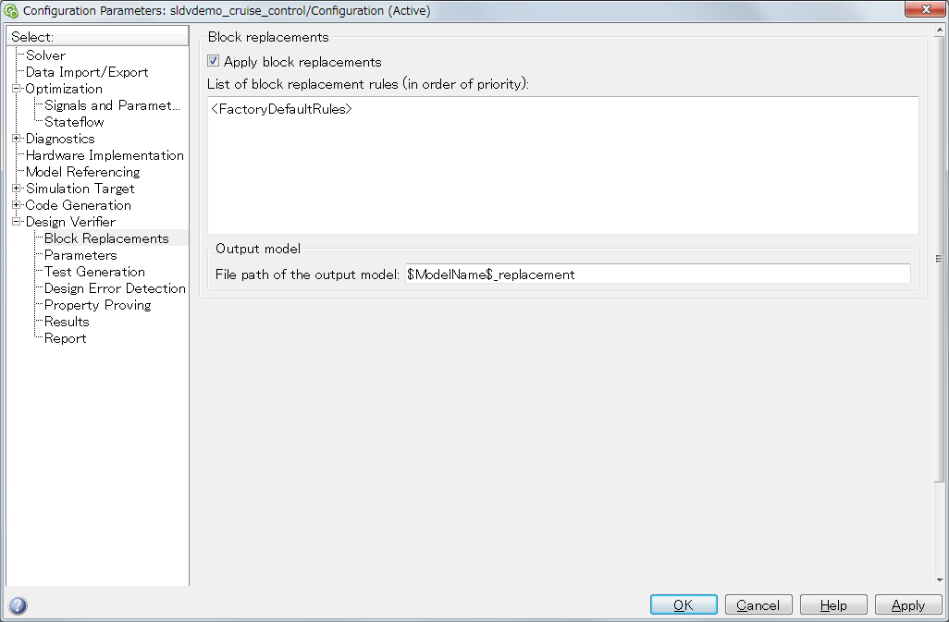
Block Replacement pane
If "Apply block replacements" is enabled, the specified rules will be applied when SLDV analyze a model.

Slide 18
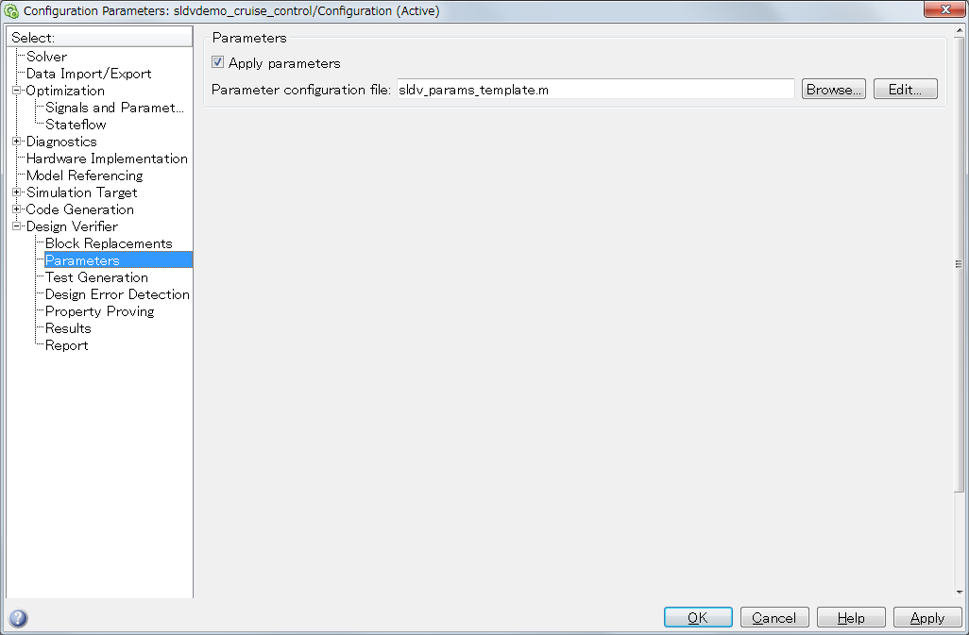
Parameter pane
If "Apply parameters" is enabled, the specified parameter configuration will be applied when SLDV analyze a model.

Slide 19
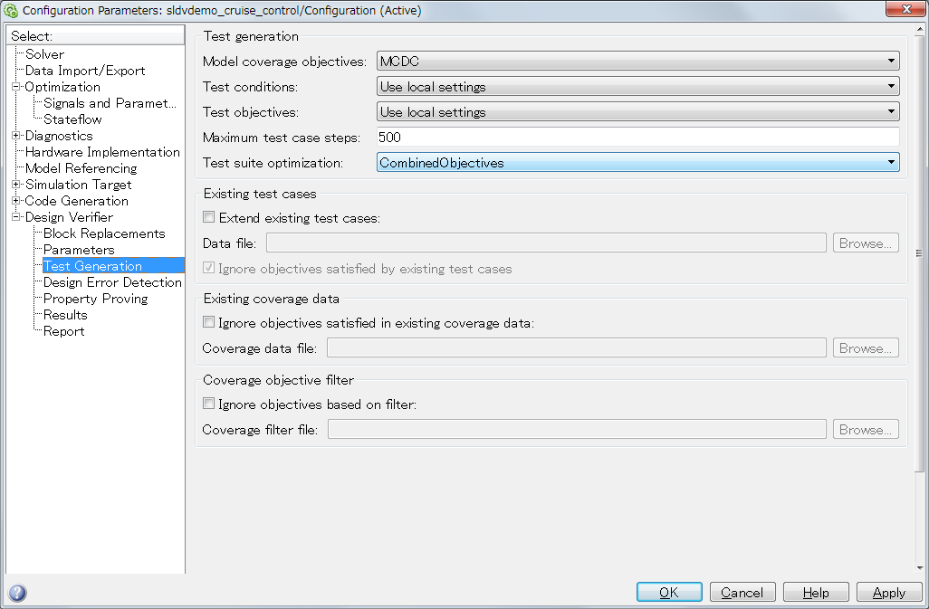
Test Generation pane

Slide 20
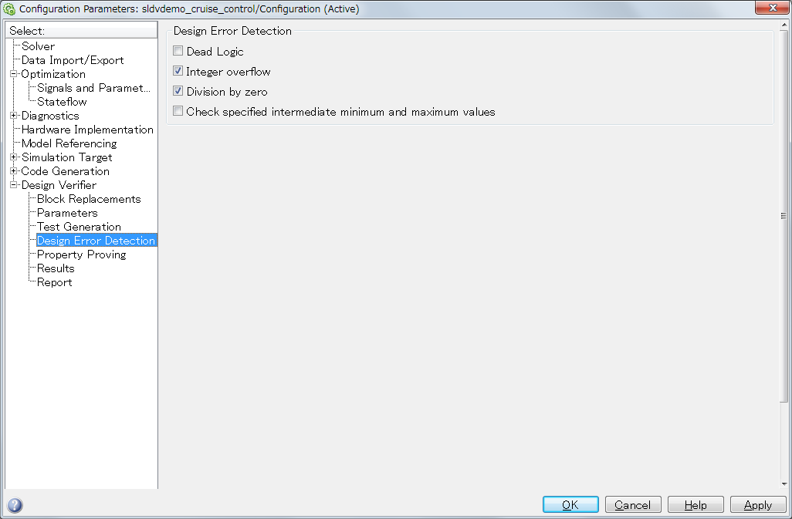
Design Error Detection pane

Slide 21
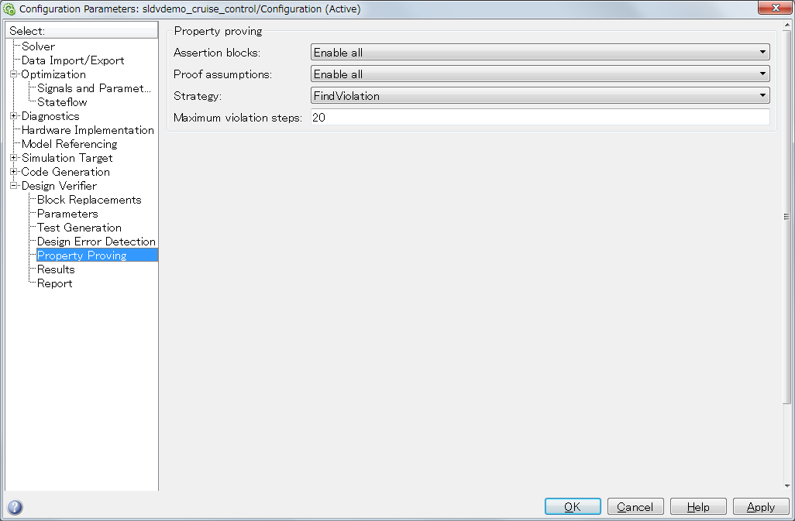
Property Proving pane
The strategy setting will influence on the result and performance of Property proving analysis.

Slide 22
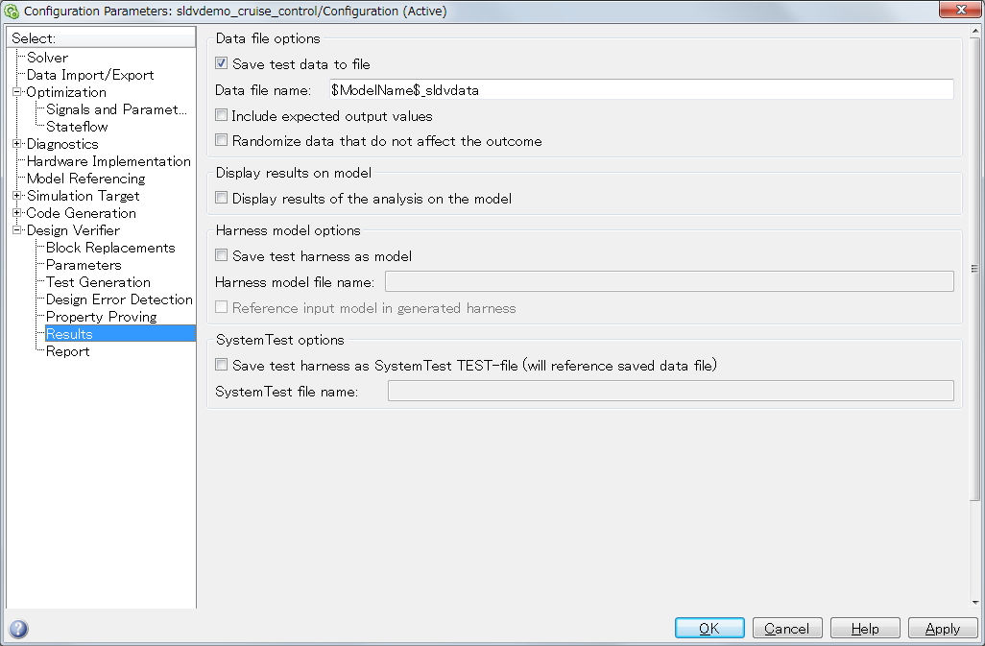
Results pane

Slide 23
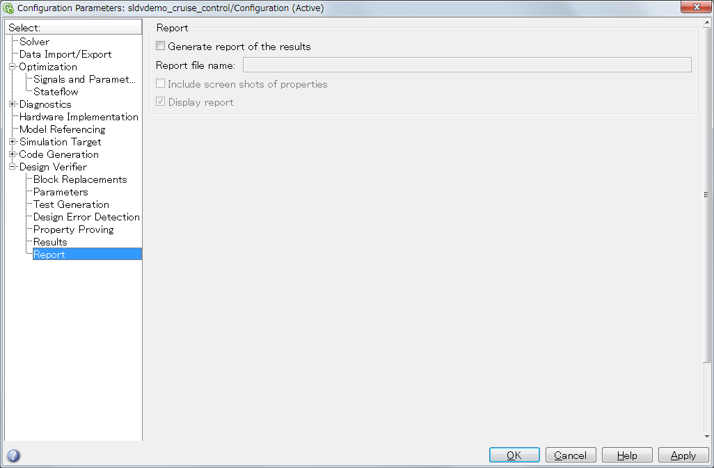
Report pane

Slide 24
sldvoptions function
A command can perform a SLDV related setup by using a sldvoptions function.
Advantage of use:
Modifying SLDV configurations without making the model dirty.
You can apply the same configuration to multiple models easily.
opts = sldvoptions();
opts.Mode = 'TestGeneration';
opts.TestSuiteOptimization = 'CombinedObjectives (Nonlinear Extended)';
sldvrun(bdroot,opts,true)

Slide 25
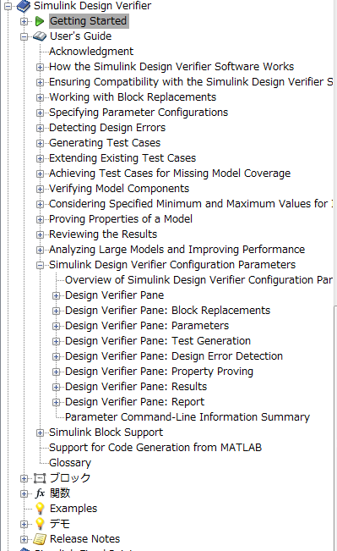
Reference to SLDV document
Document on Web : http://www.mathworks.co.jp/help/toolbox/sldv/ug/bqz8jpw.html

Slide 26
Simulink Design Verifier Blocks

Slide 27
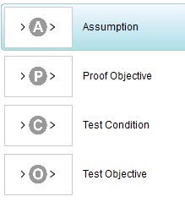
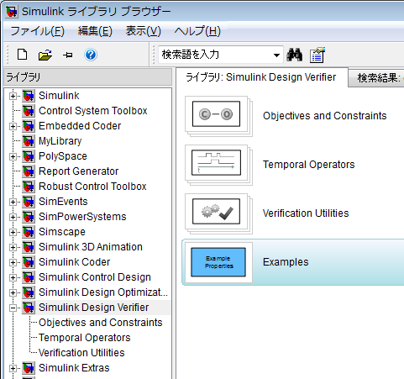
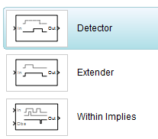
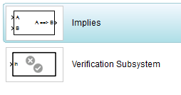
Structure of Simulink Design Verifier Blocks
* Add in R2011a.
* The library structure has been changed in R2011a.

Slide 28
Simulink Design Verifier Blocks #1
Objectives and Constraints library
Proof Objective block :
Specifying a property by this block when you run
Property Proving.
(Assertion block in Model Verification library can also be used)
Assumption block
Limit a signal range when you run Property Proving.
(Reduction of analysis space).
Test Objective block
Specifying user defined test objective with this block.
Test Condition block
The model input value at the time of test case generation is limited (reduction of analysis space).

Slide 29
Simulink Design Verifier Blocks #2
Temporal Operators (tense operator)
Detector
Detected "truth" input is delayed.
Extender
Detected "truth" input is extended.
Within Implies
If Obs never becomes true while In is true, the block outputs false.
* Add by R2011a.

Slide 30
Simulink Design Verifier block #4
Verification Utilities
Verification Subsystem block
Verification logic can be visually separated by this Subsystem.
Inside of this subsystem is out of Code generation scope.
Inside of this subsystem is out of coverage measurement.
Implies
Propositional operator: "implies"
A implies B <=> ! A || B
If A is true, B must be true.
If A is false, B is don't care.
(not A) or B
Truth table
A | B | A implies B
0 | 0 | 1
0 | 1 | 1
1 | 0 | 0
1 | 1 | 1

Slide 31
Ensuring compatibility with SLDV
Exercise folder: 02_Compatibility

Slide 32
Overview of compatibility of SLDV
To ensure compatibility with SLDV, the model should be constructed by SLDV compatible blocks and configurations.
Usually, SLDV is adopted to discrete controller model. Continuous integration often used by plant model is not supported.
Compatibility checking can be applied.
If the model includes incompatible portion, block replacement or automatic stubbing might be applied to apply SLDV analysis.

Slide 33
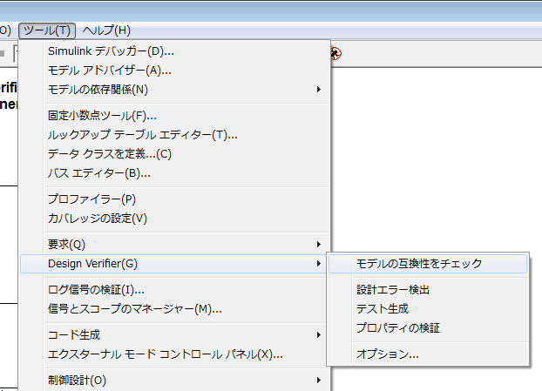
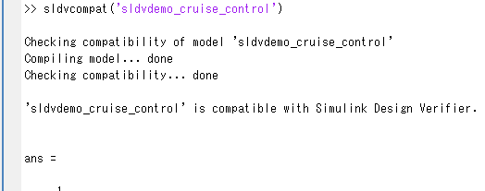
Compatibility check functionality
By a check, a check of the SLDV compatibility of the present model is possible in the compatibility of a tool > Design Verifier > model.
API: >> sldvcompat ('model name')

Slide 34
Unsupported Simulink Software Features
Variable-step solvers
Callback function (when the callback changes behavior of the model)
Model Callback function (InitFcn must be empty)
Algebraic loops
Masked subsystem initialization functions
Complex signals
Variable-size signals
Arrays of buses
Multi-word fixed-point data types
Nonzero start times
Nonfinite data (NaN, Inf)
Concurrent execution
Signals with nonzero sample time offset
Models with no output ports
Refer to the product document for the newest information. http://www.mathworks.co.jp/help/toolbox/sldv/ug/bq0mufa.html

Slide 35
Unsupported Stateflow Software Features
ml Namespace Operator, ml Function, ml Expressions
C Math Functions
Atomic Subcharts That Call Exported Graphical Functions Outside a Subchart
Recursion and Cyclic Behavior
Custom C or C++ Code
Machine-Parented Data
Textual Functions with Literal String Argument
Refer to the product document for the newest information. http://www.mathworks.co.jp/help/toolbox/sldv/ug/bq1lkr_.html

Slide 36
Unsupported MATLAB for Code Generation Features
Complex numbers
Characters
C functions
Extrinsic functions
Refer to the product document for the newest information. http://www.mathworks.co.jp/help/toolbox/sldv/ug/briyumc-1.html

Slide 37
Correspondence Simulink block
Additional Math and Discrete Library: Fully supported.
Continuous Library: Fully unsupported
Discontinuities Library : Fully supported
Discrete Library: Supported expect Discrete State-Space and Discrete Zero-Pole.
Logic and Bit Operations Library: Fully supported.
Lookup Tables Library: Supported but there are limitations in interpolation / extrapolation methods.
Math Operations Library: Partially supported. (Nonlinear operations, such as sqrt, complex number operation, etc. are not supported.).
Model Verification Library: Fully supported.
Model-Wide Utilities Library: Partially supported (Timed-Based Linearization, Trigger-Based Linearization are not supported).
Ports & Subsystems Library: Partially supported (For-each block is not supported. Some limitations are exist for conditional-executed subsystems).
Signal Attributes Library: Fully supported.
Signal Routing Library: Fully supported (Manual Switch makes dead-logic)
Sinks Library: Fully supported except Stop Simulation.
Sources Library: Partially supported.
User-Defined Functions Library: Partially supported.

Slide 38
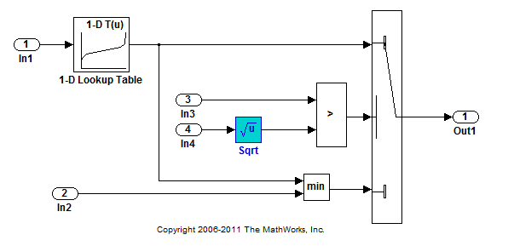
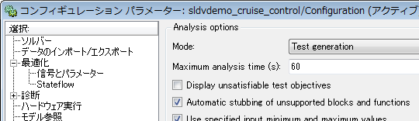
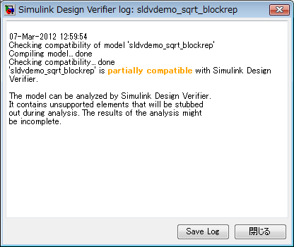
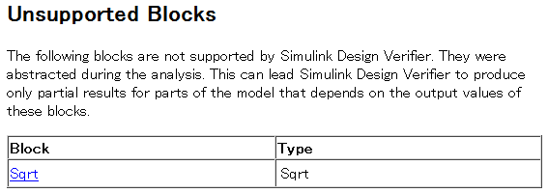
Automatic Stubbing
Automatic stubbing lets you analyze a model that contains objects that the SLDV does not support.
When you enable the automatic stubbing option (it is enabled by default), the software considers only the interface of the unsupported objects, not their actual behavior. This technique allows the software to complete the analysis. However, the analysis may achieve only partial results if any unsupported model element affects the simulation outcome
Configuration parameter
Unsupported block: sqrt
SLDV Report
With a compatibility check It becomes "partially compatible."
m_compat01.mdl

Slide 39
Other considerations
SLDV doesn't generate a test for a model which doesn't have free input (Inport, DSM, tunable parameter).
SLDV doesn't generate a test for a model without model coverage objective.

Slide 40
Model coverage analysis
Exercise folder: 03_ModelCoverage

Slide 41
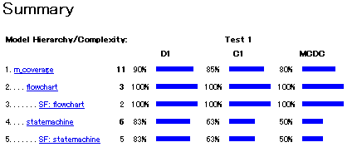
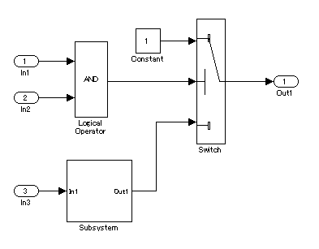
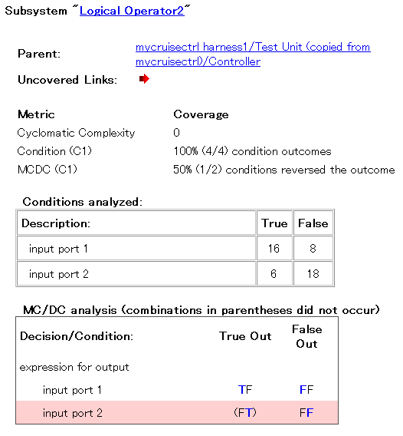
The outline of the measurement function of model coverage
It is possible to measure the model coverage at the time of a simulation by using the function of Simulink Verification and Validation.
Coverage report
Subsystem unit
test1
1
They are details the whole block.
test2
1
0
1
0
0
1
test3
0
1
test4
It is measured whether all branches in a model were performed.
Test signal

Slide 42
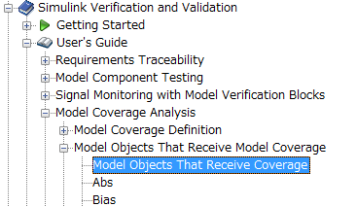
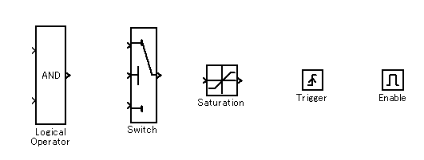
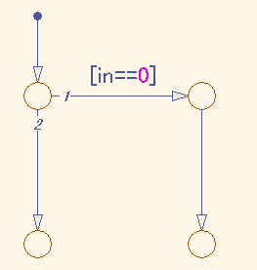
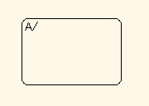
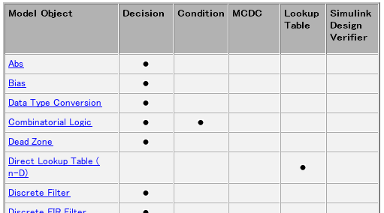
Model objects that receive model coverage
There is a list in SLVnV document.
The object block list of in a document.
Coverage objects (typical example)
Stateflow State
Stateflow Transition
Object list http://www.mathworks.co.jp/help/toolbox/slvnv/ug/bstx5sz.html

Slide 43
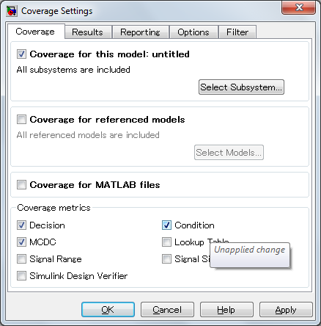
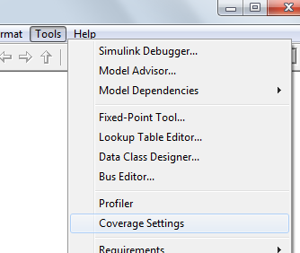
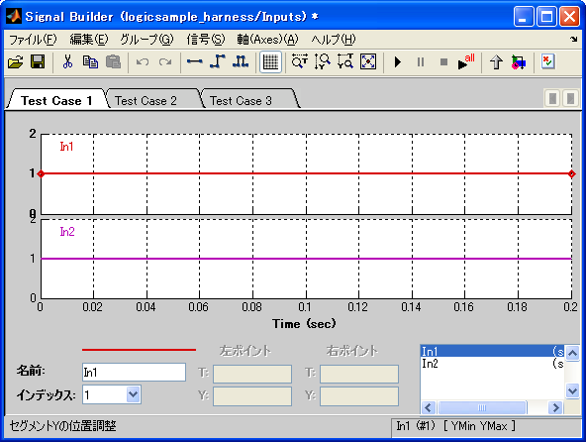
How to measure model coverage?
Enable coverage from Coverage Setting Window
"Run All" button at Signal Builder
Calling API
cvtest, cvsim, cvhtml
% Define Test object
cvto = cvtest('Model Name');
% Measure MC/DC
cvto.settings.mcdc = 1;
% Run simulation at 0-1 sec
[cvdo,T,X,Y] = cvsim(cvdo,[0 1]);
% Generate coverage report
cvhtml('covreport.html',cvdo)

Slide 44
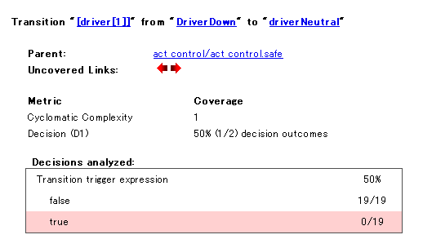
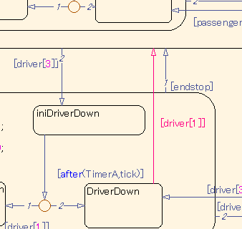
Details of a coverage report
This indicates that a test pattern for Driver's switch is missing.
Coverage report example
A click will highlight an applicable model.
Completeness of test coverage can be measured in model-level
Simulink Verification and Validation

Slide 45
Measurable coverage criteria
Decision coverage
Was each output pattern performed?
Condition coverage
Was each input pattern performed?
MC/DC coverage
Does each input affect an output independently?
Signal range coverage
The maximum and the minimum of a block output
Look-up table coverage
Was the table value used?

Slide 46
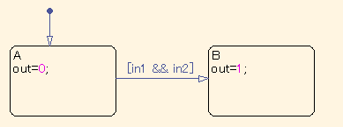
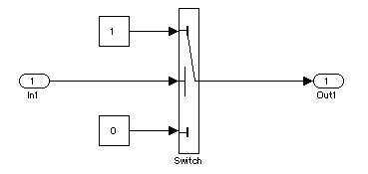
Decision coverage
It is measured whether all the output patterns of the target block were performed.
In 1 and 0, an output is. It performed.
Both the patterns in which changes occur and that do not /Occur were performed.

Slide 47
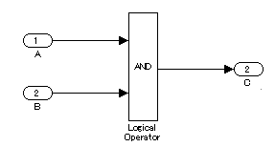
Condition coverage
It is measured whether all the input patterns of the target block were performed.
in1 and in2 were performed for True/False.
The two inputs A and B were performed for True/False.

Slide 48
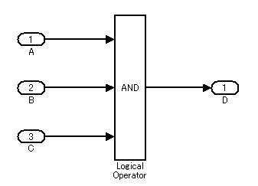
MC/DC coverage
A test case achieves full coverage for a block when a change in one input, independent of any other inputs, causes a change in the block's output.
The MC/DC achievement input pattern of a 3 input AND block
Its attention is paid to A. : B and C are fixed to 1. If A is changed with 1/0 The output D changes with 1/0. => v4, v8
 | A | B | C | D
v1 | 0 | 0 | 0 | 0
v2 | 0 | 0 | 1 | 0
v3 | 0 | 1 | 0 | 0
v4 | 0 | 1 | 1 | 0
v5 | 1 | 0 | 0 | 0
v6 | 1 | 0 | 1 | 0
v7 | 1 | 1 | 0 | 0
v8 | 1 | 1 | 1 | 1
Its attention is paid to B. : A and C are fixed to 1. If B is changed with 1/0 The output D changes with 1/0. => v6, v8
Its attention is paid to C. : A and B are fixed to 1. If C is changed with 1/0 The output D changes with 1/0. => v7, v8
Coloring line : MCDC achievement of the three input AND Input pattern

Slide 49


Signal Range coverage
The maximum and the minimum at the time of the simulation of each block are measured.
Coverage report
Example : abs block Output minimum 7.77156e-016 Output maximum 1.66667

Slide 50




Lookup Table coverage
The table value used in the Lookup Table block at the time of a simulation is measured.
Coverage report
An applicable block
Click to open detailed count how many steps was the table used.
Look-up table editor

Slide 51




Simulink Design Verifier coverage
The value (or range) specified as each block of Proof Assumption offered by Simulink Design Verifier, Proof Objective, Test Condition, and Test Objective, It becomes 100% when the connected signal is attained also at one step under simulation.
Use to the coverage definition of an user definition is possible.
Coverage report (extract)
The value of 20/51 step was 4 among the inputs to a Test Objective block during a simulation.

Slide 52

Cyclomatic complexity measurement
Model coverage report includes Cyclomatic complexity indexes. This number is used for estimating the complexity of the model.

Slide 53
Typical API of Simulink Verification & Validation
cvto = cvtest(<model>) Create model coverage test specification object
cvdo = cvsim(cvto) Simulate and return model coverage results for test object.
cvhtml(HTMLfile,cvdo) Produce HTML report from model coverage object

Slide 54



The block classification-by-color display of a coverage measurement result
an uncovered block can be distinguished at a glance by coloring the block for coverage in green and red after a simulation according to a measurement result.
Green The inside of a block or subsystem attains all coverage.
Red The inside of a block or subsystem is un-reaching to one of coverage objects.
Inside of the selected block or subsystem The display screen of a coverage attainment situation

Slide 55


The display of a coverage report
The coverage report attained in the simulation is displayed.
Coverage setting window On a model Tool > Setup of coverage
In the case of a command : cvhtml (a <HTML file name>, <coverage data>)

Slide 56


Understanding model coverage report
Model name
Author
Saved time
A model option setup related to coverage
Addition coverage report
Model whole
Subsystem unit
Object model
The first half portion of a report

Slide 57




Understanding model coverage report Decision coverage #1
Example 1
Example 2
The Switch block was evaluated 36 times (the number of simulation steps), and the case where the case where the 2nd input (considerable when one input turns into an output) is False among them was 28 times, and the 2nd input (considerable when one input turns into an output) was True was 8 times. True/False -- both were performed -- a sake -- coverage -- 100% -- it is .
Inside [ the changes object of Stateflow was evaluated 4 times ], the case (parenthesis [] inner logic. imitation) where changes conditions were not fulfilled was 4 times, the case where changes conditions were fulfilled (parenthesis [] -- inner logic -- true) was 0 times, and decision coverage was 50% (since only False was evaluated among True/False).

Slide 58


Understanding model coverage report Decision coverage #2
In the child state objects A and B of the parent state object P, while P was evaluated 10 times, A was evaluated once, and B was evaluated 9 times.
Its attention is paid to the changes object [in2 == 1] from P to C. It was 0 times that changes occur, when it was in the child state object A. When it was in the child state object B, there was a case which changes generate.

Slide 59



Understanding model coverage report Condition coverage
Between two inputs of a Logical Operator block (AND), True was evaluated 0 times and False was evaluated for the input 1 and the input 2 4 times. Inside for [ four ] coverage (2 input xTrue/False), Since only Falsex2 was evaluated, coverage will be 50%.
Inside [ the changes object of Stateflow was evaluated 36 times ], Conditions 1 "inch1==1": True 4 time, 32 imitations Conditions 2 "inch2==0": It was zero imitation true 4 time. In addition, in A&&B, since B is evaluated only when A is truth, the sum total of the conditions 2 will be 4 times.

Slide 60


Understanding model coverage report MC/DC coverage #1
Its attention is paid to the input 1. : The pattern which meets the MCDC standard since an output becomes T/F, respectively when the input 2 is fixed to T and the input 1 is shaken at T/F. Input 1=F and input 2=T are not performed before long. Its attention is paid to the input 2. : The pattern which meets the MCDC standard since an output becomes T/F, respectively when the input 1 is fixed to T and the input 2 is shaken at T/F. Input 1=T and input 2=F are not performed before long. Since 2 in a total of two patterns (its attention is paid to the inputs 1 and 2) pattern was not performed, MC/DC coverage will be 0%.
When an output is set to F
Input 1= False Input 2 = True It does not exercised.
Its attention is paid to the input 1.
Input 1= True Input 2 = False It does not exercised.
Its attention is paid to the input 2.

Slide 61


Understanding model coverage report MC/DC coverage #2
The input pattern of the three input OR
each three input -- TrueOut and FalseOut were filled
 | u1 | u2 | u3 | out
v1 | 0 | 0 | 0 | 0
v2 | 0 | 0 | 1 | 1
v3 | 0 | 1 | 0 | 1
v4 | 0 | 1 | 1 | 1
v5 | 1 | 0 | 0 | 1
v6 | 1 | 0 | 1 | 1
v7 | 1 | 1 | 0 | 1
v8 | 1 | 1 | 1 | 1

Slide 62

Understanding model coverage report MC/DC coverage #3
Since AND logic serves as a False output regardless of the input 2 when the input 1 is T, the input 2 is displayed by x.
Input 1: in1 == 1 is True. Input 2: in2 == 0 is False. It does not exercised.

Slide 63





"Treat Simulink logic blocks as short-circuited"
In the case of the three input AND
Coverage setting window On a model Tool > Setup of coverage
Disabled
Enabled
Either of TFTTFF is OKed.
Both FTT FTF FFT and FFF are OKed.

Slide 64


Coverage filtering
It is possible to eliminate a specific block type, an individual block, a subsystem, etc. from the object of coverage measurement.
m_modelcov03.mdl

Slide 65


Creation of a harness model
When the following command is used, creation of a test harness model is possible.
slvnvharnessopts : configuration of a harness model slvnvmakeharness ('model') : A harness model is created from a "model."
Exercise: h_makeharness.m
% Open a model
open_system('m_modelcov02')
% Harness model configuration
hopts = slvnvharnessopts;
hopts.modelRefHarness = 0;
% Generate the harness model
slvnvmakeharness(bdroot,[],hopts)
A dummy input
The model for a test (model reference /Copy of a model)

Slide 66


Authoring a test vector on Signal Builder by GUI
It is possible to edit the signal on Signal Builder by mouse operation, and to edit a test vector.
Example :
The change > maximum time of the axis-of-coordinates > time range is changed into 1.
It SHIFT(s) + left-clicks in arbitrary time, and is addition of the point.
A signal is dragged and a signal value is changed.
A signal is held and Y value is corrected by a numerical input.
A new tab is added by a group > copy.
It is package execution of a simulation by the Play All button.

Slide 67




Importing data from Excel spread sheet to Signal Builder.
It is possible to take the time series signal defined on Excel into Signal Builder.
d_testvectors.xls

Slide 68
Operation of Signal Builder by API
The signalbuilder command : Example : [time,data,sig,grp] = signalbuilder(block); The information on a group (tab), a signal name, Y data, and time is acquired. signalbuilder (block, 'APPEND', time, data); Y data and time are added to the existing SignalBuilder.
Exercise: 03_ModelCoverage\h_signalbuilder.m
% Open a model
open_system('m_modelcov02_harness')
% Path to the SignalBuilder
blk = 'm_modelcov02_harness/Inputs';
% Obtain signal/signal info from the Signal Builder
[time,data,sig,grp] = signalbuilder(blk);
% Adding a new group
newtime = [0 1 2];
newdata = {[0 1 0];[0 1 0];[0 1 0];[0 1 0];[0 1 0]};
signalbuilder(blk,'append',newtime,newdata)

Slide 69



Model Verification library
The validity of a simulation can be evaluated using the block of a Model Verification library.
Comparison of a floating point and a fixed-point model MILS/ SILS/PILS comparison etc.
Expected value comparison

Slide 70


Test utility: cmtdtool
The utility tool-ized based on the opinion obtained from activity of JMAAB CMTD WG (control model test design workgroup).
From Excel to SignalBuilder
The time series data on Excel are taken into a Simulink model.
From Excel to a truth value table
The truth value table described on Excel is taken into a Simulink model.
Test Harness
The coincidence check model of a test input + expected value and a control model is generated.
Report
performing the prepared test automatically -- a result -- a report -- automatic -- it generates
MATLAB Central to download is possible for this tool.
It refers to a search engine with "cmtdtool."

Slide 71






cmtdtool details #1
From Excel to SignalBuilder
The time series data on Excel are taken into a Simulink model.
From Excel to a truth value table
The truth value table described on Excel is taken into a Simulink model.

Slide 72






cmtdtool details #2
Test Harness
Generate a model for equivalence checking between expected outputs and model
Report
Automatic report generation from a harness model
Control model simple substance
A dummy test Input + expected value
Control model
An expected value and a model output の一致 comparison

Slide 73
Automatic generation of a test case
Exercise folder: 04_TestGen

Slide 74


How to call test generation
Execution from the route level of a controller model
From an Atomic subsystem
It starts and performs.
SLDV API
sldvrun(<model>,opt)
It right-clicks on an Atomic subsystem.

Slide 75

Execution of test case automatic generation to a sample model

Slide 76


Simulink-Design-Verifier log window
Under analysis
After the end of analysis

Slide 77


Test harness model
The model which performs the test generated by SLDV Test vector + Model
The generated test vector It is contained in SignalBuilder.

Slide 78


The test harness model using model reference
If the "Reference input model in generated harness" option is validated, an object model will be generated as model reference.
Separation test environment and for a test (management is separately possible)

Slide 79



An understanding of a test harness model
Copied Test Unit is a ReadOnly subsystem.
Visualization by a viewer is possible also at ReadOnly.
Adjustment of the sample time, the data type, and size of a signal

Slide 80


Simulink Design Verifier Report
Details of SLDV analysis
The explanation part of the contents of a report in a help
http://www.mathworks.co.jp/help/toolbox/sldv/ug/bq9n2e_-1.html

Slide 81
SLDV term: Objective
Objective: What is the analysis target of SLDV
Coverage objective :
Coverage object Example: T conditions of a Switch block, F conditions, etc.
Test objective
A user is a candidate for a test (after-mentioned) which can be set up arbitrarily to a signal.
Proof objective
The candidate for proof in Property proving (after-mentioned)

Slide 82
The outline of Simulink-Design-Verifier Report
Summary
Number of objectives, satisfied objectives, unsatisfiable objectives, etc/
Analysis time etc.
Analysis Information
Model Information: version, authoer, etc
Analysis Options: SLDV option configuration
Approximations: Approximation applied to SLDV analysis
Test Objective Status
Details result of each objective in a model
Model Items
A table of block or objects, coverage objectives, corresponding test case number.
Test Cases
The generated time series data and the objective which reached by the test

Slide 83




An understanding of Test Objective Status
The 2nd input of Switch is False (the 3rd input is outputted).
It corresponds to the 1st test case.
The Condition conditions of OR block: 1st input T/F, 2nd input T/F
1p | 2p | O
T | T | T
T | F | T
F | T | T
F | F | F
MCDC conditions of OR block : TF,FT,FF

Slide 84
(Recall) Understanding MC/DC coverage
Where other inputs are fixed paying attention to one input of the target block, when you shake at True/False the input to which its attention is paid, True/False and the input whose output changes should put together.
The MC/DC achievement input pattern of a 3 input AND block
Its attention is paid to A. : B and C are fixed to 1. If A is changed with 1/0 The output D changes with 1/0. => v4, v8
 | A | B | C | D
v1 | 0 | 0 | 0 | 0
v2 | 0 | 0 | 1 | 0
v3 | 0 | 1 | 0 | 0
v4 | 0 | 1 | 1 | 0
v5 | 1 | 0 | 0 | 0
v6 | 1 | 0 | 1 | 0
v7 | 1 | 1 | 0 | 0
v8 | 1 | 1 | 1 | 1
Its attention is paid to B. : A and C are fixed to 1. If B is changed with 1/0 The output D changes with 1/0. => v6, v8
Its attention is paid to C. : A and B are fixed to 1. If C is changed with 1/0 The output D changes with 1/0. => v7, v8
Coloring line : MCDC achievement of the three input AND Input pattern

Slide 85


MCDC coverage under SLDV report
OR 3 inputs
1 p | 2p | 3 p | O
T | T | T | T
T | T | F | T
T | F | T | T
T | F | F | T
F | T | T | T
F | T | F | T
F | F | T | T
F | F | F | F
1p | 2p | 3 p | O
T | T | T | T
T | T | F | F
T | F | T | F
T | F | F | F
F | T | T | F
F | T | F | F
F | F | T | F
F | F | F | F
AND 3 inputs

Slide 86


Dead logic report
1p | 2p | O
T | T | T
T | F | F
F | T | F
F | F | F

Slide 87

Approximation used by SLDV
Simulink Design Verifier applies approximation(s) depending on the model, in order to avoid becoming infinite search space. The information about this approximation is reported in the report.
Document part
Approximation Example
A floating point number is approximated as a rational number.
Linearization of a two-dimensional table
(Interpolation and extrapolation)
Restriction of the loop count of a while loop

Slide 88




Dead logic detection
When there is logic which cannot reach on the structure of a model, SLDV detects this.
Design Error Detection also detects Dead Logic
m_deadlogic01.mdl

Slide 89
(Recall) Influence of Conditional input branch execution
%Disabled
if (C~=0)
tmp = 2;
else
tmp = 3;
end
if (C~=0)
output = 1;
else
output = tmp;
end
%Enabled
if (C~=0)
output = 1;
else
if (C~=0)
output = 2;
else
output = 3;
end
end
It becomes "dead path"
condExecSample01.mdl

Slide 90

Generating a test for an Atomic Subsystem
It right-clicks on an Atomic subsystem.
API: extracting an Atomic Subsystem and make it as an independent model.
slvnvextract(<AtomicSubsystem>)

Slide 91


MAT file - sldvData
The result of SLDV analysis is saved in a MAT-file.
Configuration parameter >Design Verifier > Results
By default Model name_sldvdata.mat It is alike and is saved.
All the information for generating a SLDV report is included in sldvData.
Example
Time series data of a test signal
The block for a test
SLDV option setup
The product document on sldvData Format
http://www.mathworks.com/access/helpdesk/help/toolbox/sldv/ug/brrzinn-1.html

Slide 92

Incorporating existing tests
It is possible to generate the test signal which reaches the coverage element which the test vector prepared beforehand does not fill.
Configuration parameter
Test vector creation
Coverage ratio
The MAT file containing the existing test vector is specified.
Applying automatic test generation here
Coverage data is specified.
Labor

Slide 93

An utility to obtain missing coverage
Existing test vectors
・CSV
・MAT-file
・Signal Builder, etc
Specify a model
Model coverage measurement
Analyzing missing coverage objectives
Cumulative coverage report
Merging test vectors
Existing test signal
Model coverage measurement for existing tests
Generate missing test vectors
This tool can be downloaded from MATLAB Central: http://www.mathworks.com/matlabcentral/fileexchange/21957

Slide 94
sldvgencov function
sldvgencov - Run Simulink Design Verifier to obtain missing model coverage
[STATUS, CVDO] = sldvgencov(MODEL, OPTS, SHOWUI, STARTCOV)
runs Simulink Design Verifier on the specified MODEL using the options OPTS. Simulink Design Verifier ignores all model coverage objectives that are satisfied in the cvdata object STARTCOV. It returns STATUS of 1 if successful or 0 otherwise. Also, it measures the coverage in the new tests and returns the results in cvdata object COVDATA.

Slide 95


Test suite optimization
Performance of SLDV analysis depends on
"Test suite optimization" setting. It is important to understand differences of "Test suite optimization" setting.

Slide 96
Combined objectives
Minimizes the number of test cases in a suite by generating cases that address more than one test objective. Each test case tends to be long, i.e., it includes many time steps.

Slide 97
Individual objectives
Maximizes the number of test cases in a suite by generating cases that each address only one test objective. Each test case tends to be short, i.e., it includes only a few time steps.
This setting is typically used in the following cases:
When you would like to set the coverage object (test objective) and test case of a model to 1 to 1, and to review a test result.
When other setup is used and "Undecided" or "Produced Error" occurs in two or more test objectives. The objective number which was not able to be analyzed correctly may be able to be reduced by using "Individual objectives."

Slide 98
Large model
Minimizes the number of test cases in a suite by generating cases that address more than one test objective. This strategy is tailored for large, complex models; consequently, it tends to use all the time that the Maximum analysis time option allots

Slide 99
Long Testcases
It is a setup which generates the test case which reaches many test objectives with the smaller number of test cases. Since the calculation for summarizing a test case is needed, it is usually a setup which needs calculation load most.

Slide 100
Combined Objectives (Nonlinear Extended)
Analyzes the model using a variation of the CombinedObjectives optimization. This optimization includes improved support for nonlinear arithmetic.
Available in R2011a or later.

Slide 101
Large Model (Nonlinear Extended)
Analyzes the model using a variation of the LargeModel optimization. This optimization includes improved support for nonlinear arithmetic.
Use is henceforth [ MATLAB R2011a ] possible.

Slide 102



Finding a bottle-neck of SLDV analysis
In case of SLDV is not responding, stop the analysis and review the intermediate result. The objective of a large number relevant to it is not attained for one test objective which cannot reach.
If a bottleneck is canceled, the objective relevant to it may be able to attain easily.
Bottleneck
It does not change for a bottleneck.
Furthermore, it influences in the lower stream.
2T does not occur for a bottleneck.

Slide 103
Test Condition block Assumption block

Slide 104


A Test Condition block and an Assumption block
The blocks are used for adding constraints to analysis to the test generation and Property proving by SLDV.
The applied conditions / assumptions must be keep for all time space.
0<= speed <= 100 It analyzes under の条件.
0<= speed <= 100

Slide 105



Relation between a Test Condition block and an Assumption block
Test Condition block is used for automatic test generation.
Assumption block is used for Property proving.
Meanings of the both of the blocks are the same.
Test Condition or Assumption can be selected from a dialog
sldvblockreplacementlib has the block which can be specified simultaneous.

Slide 106
When Test Condition or Assumption blocks are used?
Reducing Analysis space
The effect of reducing analysis time
The effect of preventing the error resulting from the nonlinearity (nonlinearities) of a model
To obtain proper result
Example: Let "speed" can take within the range of 0<= speed <= 180.
Without condition / assumption, "speed" can take all values allowed by the data type.

Slide 107


Specifying constraints #1
Format:
Example: The signal can take only 1 or 3.
{1,3}
{Sldv.Point(1), Sldv.Point(3)}
Specifying closed intervals:
Example: The signal can take 0<= x <=5.
[0 5]
{[0 5]}
{Sldv.Interval(0,5,'[]')}
The same format is used for the other SLDV blocks.
How to write any is also equivalent.
Equivalent

Slide 108



Specifying constraints #2
Specifying open interval
Example: The signal can take 0<= x <5.
{Sldv.Interval(0,5,'[)')}
Mixture of values and intervals
Example: The signal can take -1, 3, and 10<x<=20.
{1,3, Sldv.Interval(10,20,'(]')}
An arithmetic series
Example: From 0 to 100 per ten
{0, 10, 20, 30, 40, 50, 60, 70, 80, 90, 100}
num2cell(0:10:100)

Slide 109




Placing Test condition / Assumption blocks #1
Inserting in a signal
Equivalent
Equivalent
Put in Verification Subsystem block.
Separate verification items from a model.
Branching from a signal

Slide 110

Placing Test condition / Assumption blocks #2
Test condition / Assumption blocks can be placed in an intermediate signal.
Conditions:
Constraints should be able to satisfied all the time.
ex. the above "Subsystem" can outputs only 1 or 3 for all time of simulation.
Contradiction with other constraint are not exist.

Slide 111

Example of applying constraint #1
The step of the beginning of a simulation is constraint to 3.

Slide 112

Example of applying constraint #2
Difference between the previous value should be less or equal to 1.

Slide 113

Example of applying constraint #3
0<= A <= 100 and 20<= B <= 25

Slide 114




Inheriting Design Min/Max setting
When "Use specified input minimum and maximum values" in a configuration parameter is enabled, A Design Min /Max set on root-level Inport or a signal object associated to a signal next to the root-level Inport is counted as constraint.
They are those with written to a product document.

Slide 115
Test Objectives -- User defined test --

Slide 116

Test Objective block
The block used in order to generate the user-defined test signal by SLDV.
SLDV generates a test case so that a value or condition specified in the block is achieved at least one step in the simulation.

Slide 117
Why is Test Objective block used?
To define user-specific coverage objectives.
By using Block replacement capability, it is possible to embed custom test objectives automatically.

Slide 118
Using Test Objective block #1
The format is the same with Test Condition block
If multiple values or ranges are specified, SLDV generates test cases that reaches all of the value or ranges at least one time step at the specified signal.
Ex. {1,2,[10 100]}
The connected signal becomes 1
The connected signal becomes 2
The connected signal becomes a value within 10 to 100.

Slide 119

Example of using Test Objective block #1
Specifying an objective related to independent signals
Generating a test case that satisfy a condition: SigA <=3 && SigB == 10 at least a time step.

Slide 120

Example of using Test Objective block #2
Specifying a test pattern that generates a time series signals by using a Unit Delay blocks.
The above model generates 1->2->1->3->1.

Slide 121


Example of using Test Objective block #3
sldv.test function is used in Stateflow and Embedded MATLAB.

Slide 122
Using SLDV effectively

Slide 123
Understanding a bottle-neck
Since SLDV is based on formal method, completion of the analysis is not ensured. In often, it might take a long time to complete the analysis.
To get better result with SLDV, understanding a bottle-neck of the analysis is important.

Slide 124

A pointer to the document
Analyzing Large Models and Improving Performance

Slide 125
Sources of Model Complexity
Complexity of model inputs due to:
Large number of inputs (The number of inputs can vary, depending on the individual model.)
Types of inputs (floating-point values, for example)
The way the inputs affect the model state and the objectives of the analysis
Number of possible simulation paths through a model
Portions of the model that cannot be reached
Large signal count in the mode

Slide 126

Influence of SLDV analysis time on the "Large number of inputs"
Consideration :
Analysis time is not simply proportional to the number of ports.
Analysis time has higher correlation with the number of objectives.
If there is no persistent information, analysis time is not slow, i.e. 80sec for 2000 objectives.
A result of experiment
State explosion does not generate without a state (only in case of combination logic).
Windows XP SP2 Pentium 4 2.80GHz 1GB Memory

Slide 127
The data type of an input
Using Boolean as a data type is encouraged rather than using an integer type or a floating point type.
A floating point data type tends to produce "nonlinearity"
It is recommended that logical part and arithmetic part are separated in modeling architecture.

Slide 128
Understanding sources of nonlinear arithmetic in Design Verifier
Cannot be represented as piecewise linear, such as
y = x*z Where both x and z are not constant.
y = 1/z Where z is not constant
Unlike control theory nonlinearities, discontinuity is ok
if (x<0)
y = -z;
else
y = z;
end
Casting from floating point to integer may introduce nonlinearity

Slide 129
Issues with nonlinearities
When a proof or test objective depends on a nonlinearity, the analysis might not decide the objective and produce an error message
Nonlinearities that do not affect objectives are ok
Special Handling: Lookup tables with 2 dimensions normally have nonlinear algorithms but are automatically approximated with linear algorithms during test generation.

Slide 130
Handling models with nonlinear arithmetic
Simplest strategy is avoidance (not always possible or practical):
Isolate nonlinear arithmetic within a system
Generate tests for subsystems that are linear
Use Design Verifier for logically intensive aspects.
Several techniques can address nonlinearities:
Use Large model strategy
Leverage existing test cases (sldvgencov, etc.)
Discretize inputs with constraints
Approximate nonlinearities (replacements)

Slide 131
Large model strategy
This helps the analysis of nonlinearities by grouping objectives into small sets so that further optimizations can be performed.
Benefits - Simple and automatic
Suggested Practice:
Try using large model strategy before other nonlinear handling techniques.

Slide 132
Leveraging existing test cases
This helps analysis when problem objectives are eliminated using the existing test cases.
Benefits
Makes analysis simpler
Leverages meaningful test cases.
Suggested practice:
Consider using existing test cases when they exist.
Consider manually creating test cases that satisfy objectives depending on the nonlinear portions of a model.
Use sldvgencov to eliminate objectives.

Slide 133
Discretize inputs with constraints
This helps the analysis by forcing free inputs to be one or more constant values.
Benefits - can remove nonlinearities and can be combined with other techniques.
Challenge - Need to know which inputs cause nonlinearities and you also need to know appropriate values.
Suggested Practice:
Use sparingly for specific inputs (e.g., engine speed in powertrain application)
Keep constraints simple (~5 or fewer constant values)

Slide 134
Approximating nonlinearities (replacements)
The goal is to remove the nonlinearity from block or subsystem by providing an approximation that is linear.
Benefit - Potential for large perfomance improvement. Can be implemented with different levels of precision.
Challenge - Time consuming to implement. Requires some understanding of model behavior.
Suggested Practice:
Use after other techniques. Start with simple, less detailed approximations (e.g. replace an entire subsystem with a constant or gain).

Slide 135

Block relpacement
Exercise folder: 05_BlockReplacement

Slide 136


What is Block Replacement?
Block replacement enables a user to replace a block before running SLDV analysis and use non-replaced block in harness model.
sqrt block is not supported by SLDV
Test cases are generated against replaced model.
In the harness model, the original block is used.
Original model
Block replaced model

Slide 137
Use cases of Block replacement
To avoid limitation of SLDV Support Blocks. Making non-supported blocks as supported blocks.
The Automatic Stubbing function introduced from R2009a.
Embed custom test objectives to achieve complex coverage such as rather than MC/DC.
Ex. Boundary value coverage.
Applying abstraction to reduce complexity of the model
Ex. Replace a timer library block to simplified timer block.

Slide 138





A setup required for block substitution
(3) M file which described the rule at the time of substitution (those with a template)
(1) Application of block substitution, and specification of a rule definition file
(2) Preparation of the library for replacement
The block for replacement It prepares as a mask subsystem.

Slide 139

The block substitution rule (1) currently prepared beforehand
>> sldvblockreplacementlib
1-D Lookup Table
Test Objetctive is embedded at each table value.
Multiport Switch
Selector
C and A blocks are automatically set up so that an input may not remove an acceptable value.

Slide 140


The block substitution rule (2) currently prepared beforehand
The rule file is prepared below for matlabroot\toolbox\sldv\sldv\private.
A rule file name and its explanation
The explanation part in a SLDV product document

Slide 141






The example of replacement of the block corresponding to un- -sqrt block-
The inside of test harness is the block before substitution.
Object model
The block corresponding to un-
Test case generation
Block substitution Model (temporary)
Test harness
The replaced Sin block is transposed to LookupTable along with a rule.
m_blockrep01.mdl

Slide 142



Ex. Boundary value test of an integer and a fixed point
Adding Test Objectives to achieve boundary values at Saturation, Compare, and Compare to Constant blocks.
cruise_control_sdo.mdl

Slide 143
Parameter configuration
Exercise folder: 06_ParameterConfiguration

Slide 144

What is Parameter Configurations?
SLDV can treat block parameters in your model as variables during its analysis.
Make calibration parameters tunable. (When variant management is done by parameter values, let SLDV treat them as tunable values.)
Reduce difficulty of analysis such as shrinking timer count value to a smaller value.

Slide 145



A required setup
A Parameter setup is validated.
The MATLAB file which specifies the Parameter value to set up is described.

Slide 146

The format of a configuration file
The template is prepared beforehand. >> edit sldv_params_template
Format:
param.<VariableName> = rhs
rhs: value or the range
How to write the right-hand side : [0 1] ==> 0 <= x <= 1
{0,1} ==> 0,1 Sldv.Interval(0, 1, '()') ==> 0 < x < 1
* A, the same format as SLDV blocks

Slide 147



example 1 The check of operation by a simple model
Since the 2nd input is a constant, it is generated by the dead path.
Ver performs analysis as 0 or 1.
The value of Ver is changed and a test vector is generated. It is not generated by the dead path.
Parameter configuration file

Slide 148




Example 2: Shrinking a timer count value.
It becomes a bottleneck of analysis in order to carry out a CountStep cycle count.
Reducing CountStep from 100 to 5.

Slide 149



Example 2: the analysis time according to SLDV by setting a counter value as a small value -- shortening #2
The changed parameter values are used at the time of the simulation of a harness model.
It is the end of analysis at a short time by change of a counter value.

Slide 150
Notes
Changing the fundamental sample time is the easiest way of shrinking multiple timers / counters.
If multiple timer counts are modified, it needs to be ensured that the modifications doesn't change the behavior of the model.
In case of comparing outputs with C codes such as SILS or PILS, the parameter configuration is not applied on the code.

Slide 151
Property proving

Slide 152


2.1 Property proving
The functionality to prove that logical expression(s) in the verification model is always meet with the controller model
Controller model
Requirement specification
verification specification
Is the controller model always meet with logical expression(s) in the verification model?
Verification model
Automatic equivalency checking between requirement and model
Simulink Design Verifier

Slide 153




2.2 Analysis result by Property proving
The analysis result:
Proof report
Truth:
It is proved for infinite time period or specified time period.
-> a proof report is generated.
False
Counter example(s) will be generated as evidence(s).
A model containing counter example
Simulink Design Verifier

Slide 154

2.3 Property proving Model example
Verification Subsystem
The signal relevant to the properties

Slide 155

2.4 Property proving - Example of property Description
Down signal shall be continued at least 1 sec if an obstacle is detected.
Down signal shall be continued at least 1 sec if an obstacle is detected. (Stateflow representation)
Prove that input of P block is always true
Assumption
Simulink Design Verifier

Slide 156



2.6 Property proving - Debugging counter example
If a property is falsified, you can debug it by simulating the harness model. The cause is included among requirement specification, controller model, verification specification, or verification model.
Only human being can justify the correctness.
This property is falsified.
Down signal shall be continued at least 1 sec if an obstacle is detected.
Counter example
Harness model
Down signal is finished in 0.8 sec.
Simulation
Simulink Design Verifier

Slide 157

Example of description #1 of a verification order title
Propositional logic: Use of A implies B = B is truth if > A is truth. (When A is an imitation, truth and an imitation can take B)
(not A) or B
Truth value table
A | B | A implies B
0 | 0 | 1
0 | 1 | 1
1 | 0 | 0
1 | 1 | 1
When an obstacle is detected (it is not dependent on all switch operation), it verifies that down directions serve as truth and rise directions become false.

Slide 158


Example of description #2 of a verification order title
Description using a truth value table
Combination description of a logic value
The description pattern by an inspection Boolean expression
"-" -- T/F -- both mean O.K.
(not A) or B

Slide 159


Example of description #3 of a verification order title
Description by the state transition diagram of Stateflow

Slide 160

Example of verification order title description #4
Programming description by Embedded MATLAB
Expression by text description is possible in a Boolean expression etc.

Slide 161


Example of verification order title description #5
Block description using a tense logical block
>> sldvdemo_TOBlocks
Once it becomes truly, 5 step 続けて output of the truth will be carried out.
If a sensor is set to HIGH Unless it is reset, CMD continues 5 step truth.
The example of use
In2 will be set to 5 step 遅れて INACTIVE if In1 is set to ACTIVE.
In3 will be come to less than five steps by off In3, if ON and In4 are smallness from a threshold value.

Slide 162




Details of a Detector block
Output type = a fixed time interval output does not synchronize with an input. Step time over input detection = 1 If one step of inputs T continue, an output will become T behind. Delay step time = 2 A delay time step until an input is detected and an output is set to T Step time over an output interval = 3 The step time interval at which an output continues T
Output type = synchronization If an input is set to F, an output will also be immediately set to F. Step time over input detection = 3 If an input is set to T, T will be outputted to 3 step eye.

Slide 163




Details of an Extender block
An extended period = limited The period which extends the output T when detected Step time extended = 3 After an input is set to F, 3 step-time output is set to T.
An extended period = infinity Once it is detected, an output will be forever set to T.

Slide 164


Within Implies
0 to 8 seconds: Since Obs was set to T while In continued T (2 to 7 seconds) (5 to 6 seconds), Out continues T. 8 to 15 seconds: Since Obs was not once set to T while In continued T, Out is set to F immediately after setting In to F.

Slide 165
What is proved by Property proving?

Slide 166
Tense logic and non-tense logic
Non-tense logic: Logic proposition of not depending on time
The proposition which does not depend on time but is materialized
You must always be OO (don't become).
Tense logic: Logic proposition of time dependence
The proposition materialized depending on time
O If O is materialized, □ □ will become truly within x.
O It will become □ if the last value of O △ Becomes.
As for easy tense logic, verification of non-tense logic generally tends (full time search is required) to take time to verification.

Slide 167
If it P Becomes, Q will consider.
P domain whole
(1)
Q domain whole
The abnormal domain of Q
(2)
The normal domain of P
The normal domain of Q
The abnormal domain of P
(4)
(3)
(1) Q is normal if P is normal. (2) Q is not abnormal if P is normal. (3) Q is abnormal if P is abnormal. (4) Q is not normal if P is abnormal.

Slide 168
If P is normal
P domain whole
(1)
Q domain whole
The abnormal domain of Q
(2)
B
A
The normal domain of P
C
The abnormal domain of P
The normal domain of Q
A critical phenomenon
(1) Q is normal if P is normal. ex: If a switch of operation is ON, OO will operate. (2) Q is not abnormal if P is normal. ex: If a halt switch is ON, it will not go into starting mode.
A: Proof B: Left-hand side breaks (outside a normal domain). C: Violation

Slide 169
If P is abnormal
P domain
(3)
Q domain
The abnormal domain of Q
(4)
B
A
The normal domain of P
C
The abnormal domain of P
The normal domain of Q
A critical phenomenon
(3) Q is abnormal if P is abnormal. ex: If an abnormal state is detected, it will go into evasion mode. (4) Q is not normal if P is abnormal. ex: In an unexpected input, processing is not continued.
A: Violation B: Right-hand side breaks (among normal domains). C: Proof

Slide 170
Normal (forward)
(1) Q is normal if P is normal. (3) Q is abnormal if P is abnormal (opposite 偶).
The example which cautions tend to cover with a required test since it may become false negative (False Negative) when the conditions of P are not fully taken into consideration
If the switch A is ON, X will operate (are the conditions which should be set to NG of operation by states other than the switch A taken into consideration?).
The normal domain of Q
The normal domain of P
The abnormal domain of P
The abnormal domain of Q

Slide 171
Abnormal system (backward)
(2) Q is not abnormal if P is normal.
(4) Q is not normal if P is abnormal.
There is usually no statement in specifications for back logic.
It is suitable for solving a critical problem.
Although it may become false positive (False Positive), specification becomes clear by doing review and correction of.
ex:
If speed is outside the minimum and greatest range, it will not go into regular mode.
The normal domain of P
The normal domain of Q
The abnormal domain of P
The abnormal domain of Q

Slide 172

Consideration of implies operater
P->Q is always the truth if P is always false.
P | Q | P -> Q
0 | 0 | 1
0 | 1 | 1
1 | 0 | 0
1 | 1 | 1
(not P) or Q
Generating Test to achieve P == true can solve this issue.

Slide 173
The best practice of working with Property Proving

Slide 174
About Property proving
Test case automatic generation and the same technology as a design error detection function (R2011a or subsequent ones) are used, and Property proving may receive the limit about the same performance fundamentally. However, since the strict nature of a result becomes important unlike other two functions, a problem cannot be simplified or abstracted. Usually, when for [ of a model / a dynamic element and for verification ] do not influence directly, a result can be obtained in a short time. On the other hand, even if it seems that the object reaches after a long time delay, for example in order to make proof successful, SLDV must search about the behavior in which all the attainment is possible.

Slide 175

Proving Strategy setup
Property proving has three kinds of strategy setup, and performance is affected greatly.
Prove
All the behavior of a model is scrutinized and it proves that there is no violation of a property.
Find Violation
The mode which searches for violation of a property. It searches for there being no violation of a property into the set-up step number "Maximum violation Steps." More nearly high-speed generally than "Prove", when there is violation.
Prove with violation detection
"Find Violation" is performed first, and "Prove" is performed when there is nothing into the number of steps to which violation of a property was set.
A strategy setup has big influence on the performance of Property proving.
Explanation page of PropertyProvingStrategy : http://www.mathworks.co.jp/help/toolbox/sldv/ug/bry6l9v-1.html#bry6l9v-8

Slide 176

The example of a model with a remarkable difference in Proving Strategy
Only in output =Cnt, it is to fulfill assertion conditions.
It proves that an output is smaller than Cnt. Since Saturation of the preceding paragraph contains Cnt, violation of a property occurs.
Counter logic which adds every [ 1 ]. Saturation conditions are set up in Cnt.

Slide 177

The example of the anti-example analysis time for every strategy
In Prove, Find Violation and Prove with violation detection may take a long time also in the case which finishes with an instant. ? In "Prove", in order to perform all the search, analysis time increases exponentially. ? In "Find Violation", since restrictions are imposed to time, a solution can be obtained comparatively in a short time.
* Even when carrying out Prove, time to start Prove may be able to be shortened by eliminating a comparatively simple error by Find Violation in advance.

Slide 178
The device to the performance problem of SLDV
Property proving outputs/"there is nothing" an anti-example "is."
A solution may not be obtained by within a time [ realistic ] depending on a model.
Wisdom attachment by a user may be required and it is 。.
In order to prove that there is no anti-example, it is necessary no to look for patterns, and the end of analysis can be predicted in advance.
The propriety of all the path complete coverage by test vector automatic generation can serve as an index which measures attainment nature.
When the part which cannot reach by test generation relates to the candidate for proof, also in Property proving, it can become a bottleneck.
The method of wisdom attachment
And it is a restriction => Assumption block. [ the input of a model ]
Restriction about the direction of time to analyze = > Find Violation strategy
Formation of a subcomponent
Abstraction of an unrelated portion
Parameter-izing and reduction of a counter value

Slide 179
The technique which raises the performance of the Property proving to a large scale model
Violation of a property is detected at the time of the design of a model.
Violation of a property is detected from the stage before a large-scale model is completed in the "Find Violation" strategy.
Prove mode and Find Violation mode are combined.
The next page explains.

Slide 180
Prove mode and Find Violation mode are combined.
Analysis for about 5 to 10 minutes is performed by "Proving." When a clear anti-example exists, or when the property to prove is not related to the dynamic characteristic of a model, SLDV analysis is completed in time of this level.
"Find Violation" is performed and the number of the maximum steps is set about to four to six. When the simple violation of a property is included in a model, it is discovered now.
The number of the maximum steps of "Find Violation" is set as a bigger value. The limit of analysis time or a memory appears depending on the case. Please think over again about the changes etc. which require the number of steps generated with the combination of the dynamic characteristic of a model, and the conditions in a model.
if it seems that an anti-example is not found in "Find Violation" of 30 to 50 step -- "Prove" -- the maximum analysis time -- comparatively -- it is large (about several hours) -- it carries out and performs again.
http://www.mathworks.co.jp/help/toolbox/sldv/ug/brsd0x1-7.html

Slide 181





Property proving to a large scale model Best practice
Prove 5-10 [Part]
Find Violation
４～６ [Step]
Find Violation
30～50 [Step]
Prove
3～4 [時間]

Slide 182
Design error detection
Exercise folder: 08_DesignErrorDetection

Slide 183
About a design error detection function
The function to verify that the next error does not occur on a model
Zero rate
An integer and fixed-point overflow
Signal range violation to the maximum and the minimum specified by the middle variable
Dead logic
When there is a violation pattern, the anti-example which shows it is created.
It is error detection at the time of the execution which Polyspace can verify on the C code. Detection is possible on a model.
Use is henceforth [ R2011a ] possible.

Slide 184



Overflow, automatic detection of a zero rate
The design error detection functions generated at the time of a simulation are additional overflow and specification of a zero rate.
Effective input data can also cause unexpected behavior and a result.
Overflow, the main influences which a zero rate has
abnormal operation and operation fault
zerodiv01
Notes:
You use the design error-detection mode in Simulink Design Verifier to discover integer overflow and division by zero. The. analysis is automated, and it does not require. any additional user. input. Permissible ranges. for all signals on all. blocks are provided. to guide you in finding. the root cause of the. problem.At the end of the analysis you can review the results directly in the model or in an HTML report.
In the model, blocks are marked as green, yellow, or red. Green blocks have been proven unable to cause integer overflow or division. by. zero. Yellow blocks occur when the analysis cannot produce a conclusive result or when the time limit for the analysis has been . exceeded. When an error is found upstream in the model execution path, all subsequent blocks in that path that can exhibit integer . overflow and division by zero are marked yellow.
Red blocks can exhibit design errors. For red blocks, Simulink Design Verifier generates a test case that can reproduce the problem during simulation or testing.You can invoke the test case and run a simulation directly within Simulink.
How to demonstrate:
Open the model sldvdemo_cruise_control_fxp_defective
Run Tools -> Design Verifier -> Detect Design Errors
At the end of the analysis select the option: Highlight Model
SLDV uses the formal method as Polyspace i.e. of a abstract interpretation of the system via C code generation to detect . these errors.

Slide 185






Detection of signal range violation
Violation when the maximum of a signal range and the minimum are reached is detected.
Violation detection of the maximum and the minimum
It proves being based on the value as which the design value was specified.
The test case for reproducing violation after violation detection is generated.
signalrange01
Notes:
Must be suitable for customers as the slide will be made available for external use at the time of release.
Motivation
Solution (Added Details)
More details as appropriate. How does it integrate with other features and products?
Doc Reference
In addition to release notes, which should be the source for most of the information on this slide. Add a doc reference if possible.
Demo
Shipping demo name
Limitations, Known Problems, and Workarounds
What are the current limitations?Are there problems end users arelikely to run into?Are there Workarounds?Is anything likely to break, not just feature or product but interoperability with other products?
Questions and Debugging Tips (for MathWorks Support team)
What questions might end users ask?
What should Support try out when end users run into problems?
Are there any debugging tips or processes Support should follow?
Release Number ? Tech Marketing to add icon closer to release date.

Slide 186




Dead logic detection
The path which is not performed on a model is detectable.
The option of dead logic detection adds to design error detection.
A Polyspace algorithm is used for efficient detection.
Automatic report generation of a detection result, and a dead logic part highlight display
sldvdemo_fuelsys_logic
Notes:
Must be suitable for customers as the slide will be made available for external use at the time of release.
Motivation
One or two sentences describing the problem in terms of how customers phrased or think of the issue.Consider both the. feature and the workflow motivations.
Solution (Added Details)
More details as appropriate. How does it integrate with other features and products?
Doc Reference
In addition to release notes, which should be the source for most of the information on this slide. Add a doc reference if possible.
Demo
Shipping demo name
Limitations, Known Problems, and Workarounds
What are the current limitations?Are there problems end users arelikely to run into?Are there Workarounds?Is anything likely to break, not just feature or product but interoperability with other products?
Questions and Debugging Tips (for MathWorks Support team)
What questions might end users ask?
What should Support try out when end users run into problems?
Are there any debugging tips or processes Support should follow?

